Slide 1
DMA Course Project(18ECSC301) 2020-21 Title 5DMACP17 Hostile Post Detection In Hindi
Team Members *Varun Bohara 01fe18bcs278
*Madhurika G 01fe18bcs284
*Sakshi Tahlani 01fe18bcs271
*Abhishek Rao 01fe18bcs297

Slide 2
Introduction
Challenge is hosted on Codalab.
Proposed by SHARED TASK @CONSTRAINT 2021..
Important Dates:
October 1, 2020: Release of the training set and validation set.
December 1, 2020: Release of the test set.
December 10, 2020: Deadline for submitting the final results.
December 12, 2020: Announcement of the results.
December 30, 2020: System paper submission deadline.

Slide 3
Hostile Post Detection in Hindi
Our goal is to label a variety of posts in Hindi Devanagari script collected from Twitter and Facebook.
The set of valid categories are fake news, hate speech, offensive, defamation, and non-hostile posts.
It is a multi-label multi-class classification problem where each post can belong to one or more of these hostile classes but the non-hostile posts cannot be grouped with any other class.
Definitions of the class labels:
Fake News: A claim or information that is verified to be not true.
Hate Speech: A post targeting a specific group of people based on their ethnicity, religious beliefs, geographical belonging, race, etc., with malicious intentions of spreading hate or encouraging violence.
Offensive: A post containing profanity, impolite, rude, or vulgar language to insult a targeted individual or group.
Defamation: A mis-information regarding an individual or group.
Non-hostile: A post without any hostility.

Slide 4
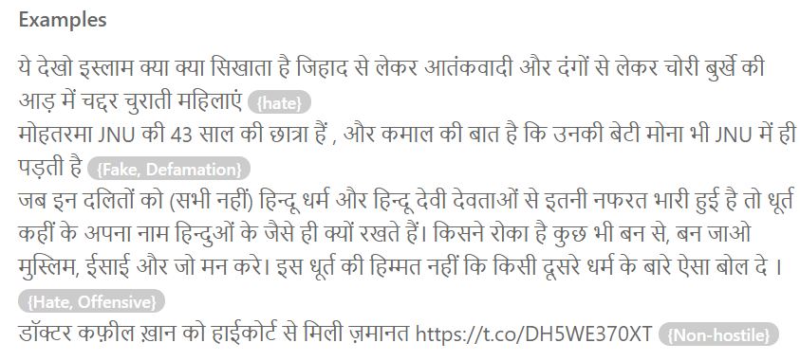

Slide 5
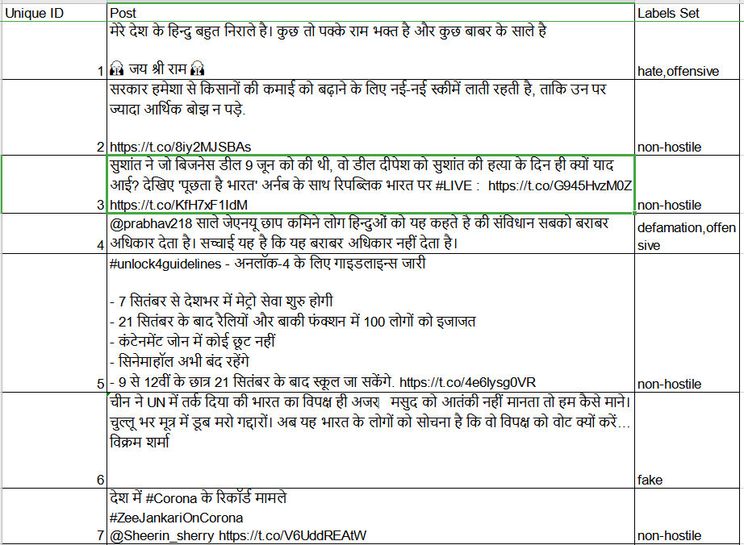
. Submission: A csv file in the following format for the final evaluation <unique_id, {labels}>
Data Set Description
Unique ID
Post
Labels Set
Constituents of Post:
Links
Special Characters - (@,/,:,#)
Alpha numerical
Emoji

Slide 6
Understanding of Data
Training Dataset : Constraint_Hindi_Train.xlsx Size : 5728 x 3 List Attributes : Unique Id,Post,Label Set Constituents of Post : Links ,Special Characters (@,/,:,#),Alpha numerical,Emoji. Format : Excel Validation Dataset: Constraint_Hindi_Train.xlsx Size : 811 x 3 List Attributes : Unique Id,Post,Label Set Constituents of Post : Links ,Special Characters (@,/,:,#),Alpha numerical,Emoji. Format : Excel

Slide 7
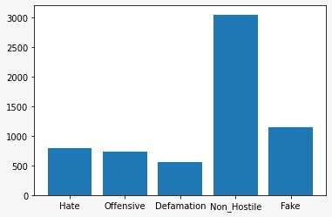
Data Interpretation
There's no uniformity in the dataset interms of the labels. This may lead to the model learning non hostile post more efficiently when compared to the other.

